Slide 1
NSRAP Highlights
2012-2013

Slide 2
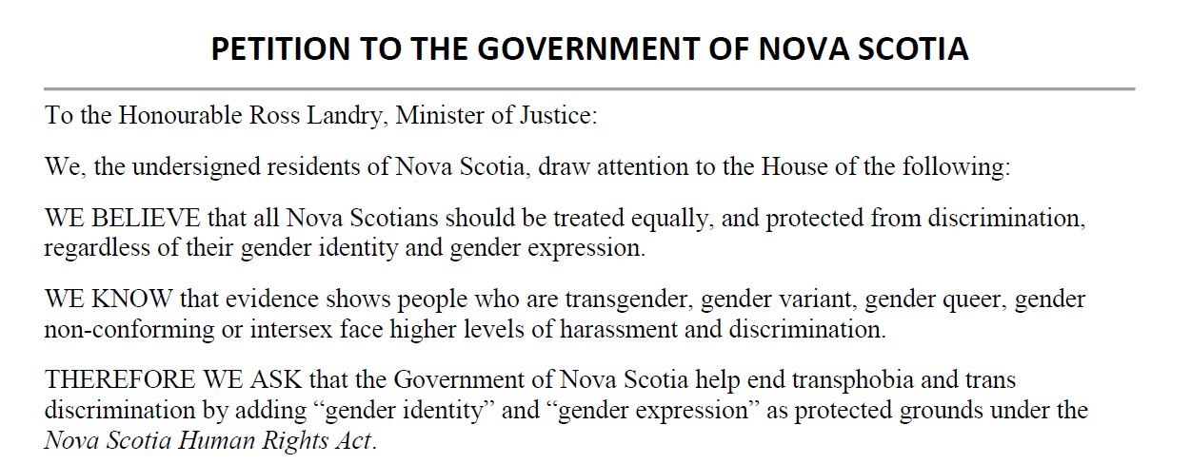
July 2012
Launch of a petition to amend the Nova Scotia Human Rights Act to include gender identity and gender expression.

Slide 3

July
Take Pride in Your Sexual Health campaign aimed at gay/bi men to get tested.

Slide 4
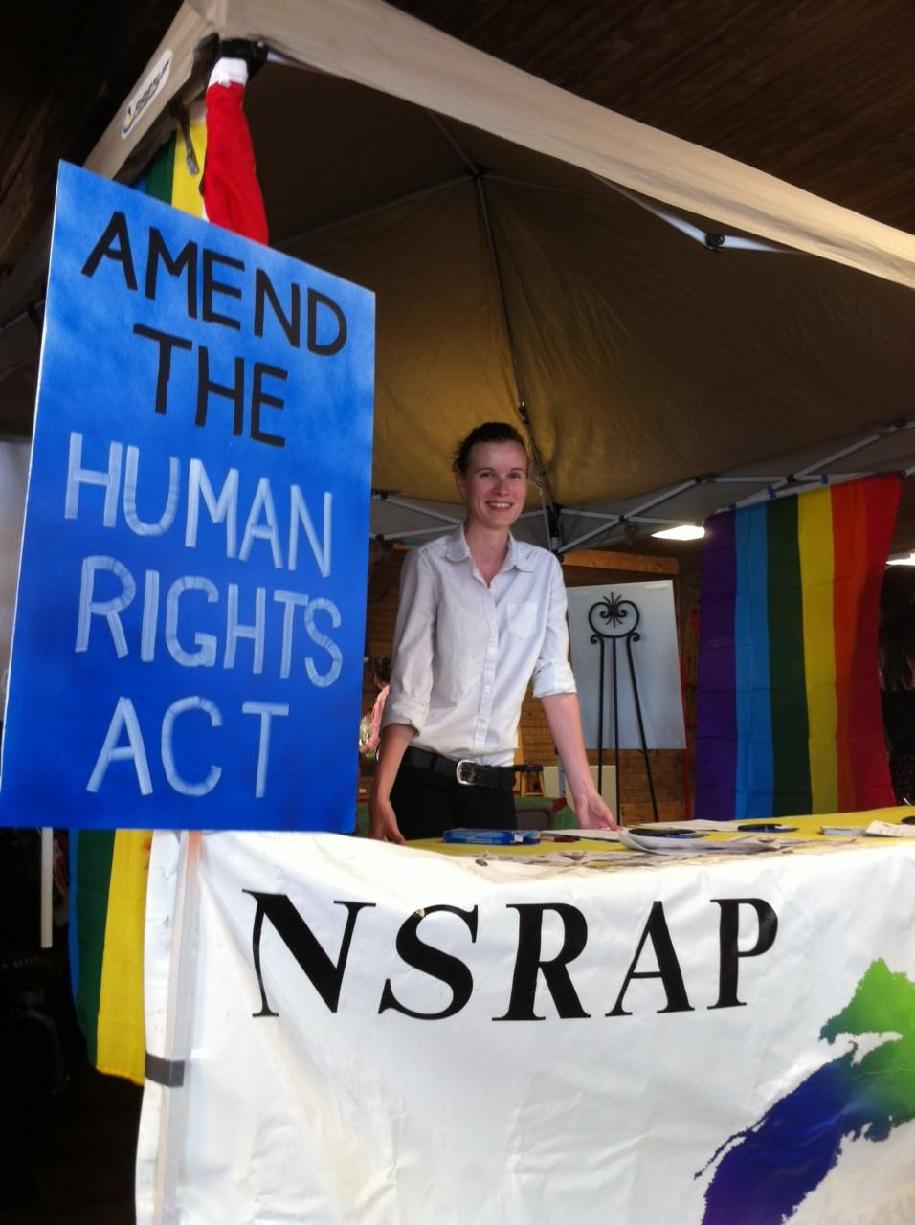
July 18
Pride Night @ Wolfville Farmers’ Market – NSRAP Board member Brenda Merrit and local volunteer Megan (pictured) collected signatures for our human rights petition.

Slide 5
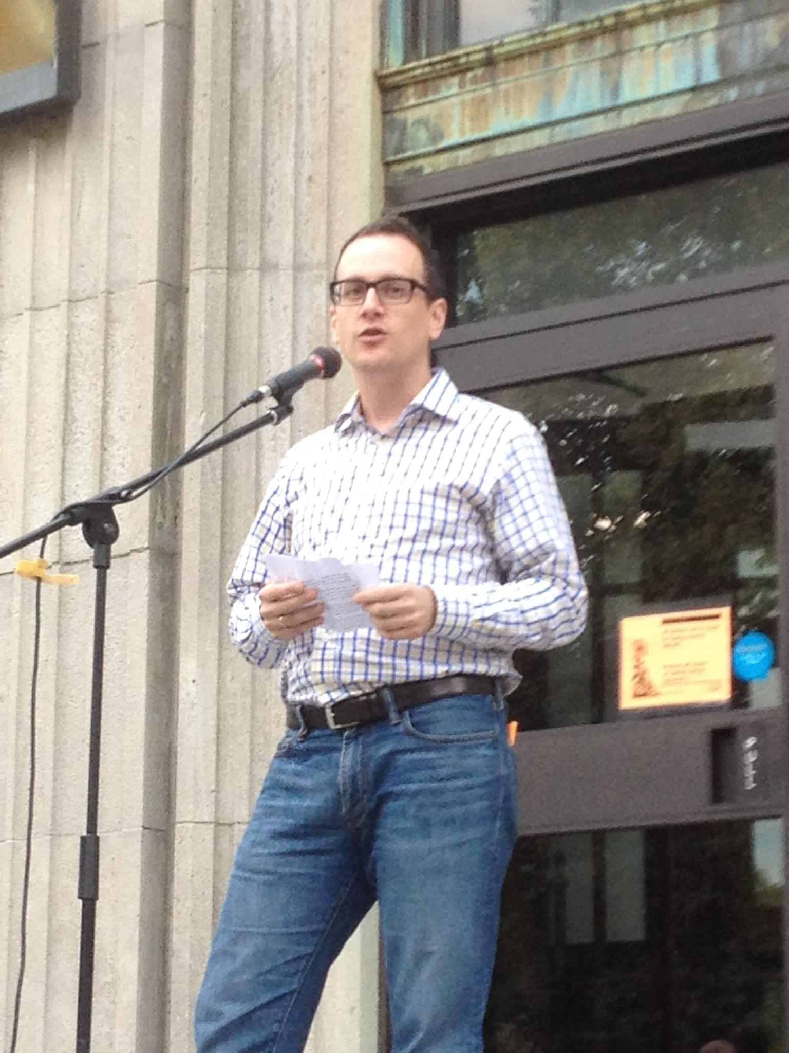
July 20
Chair Kevin Kindred address the first-ever Halifax Pride Vigil.

Slide 6
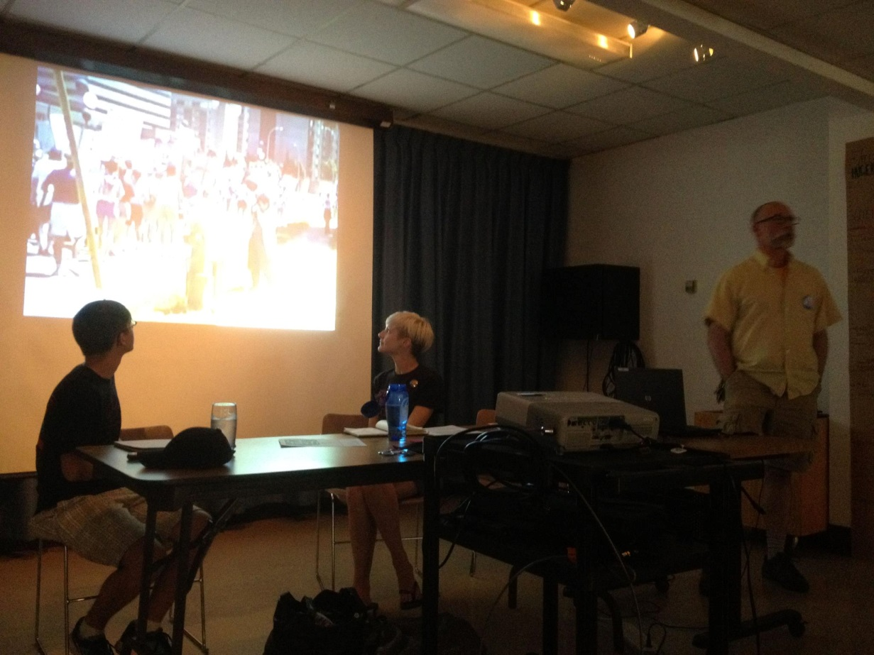
July 24
timeOUT: The State of Pride: Roots & Grassroots
Presenters: Andrew Jantzen, Rebecca Rose and Chris Aucoin

Slide 7
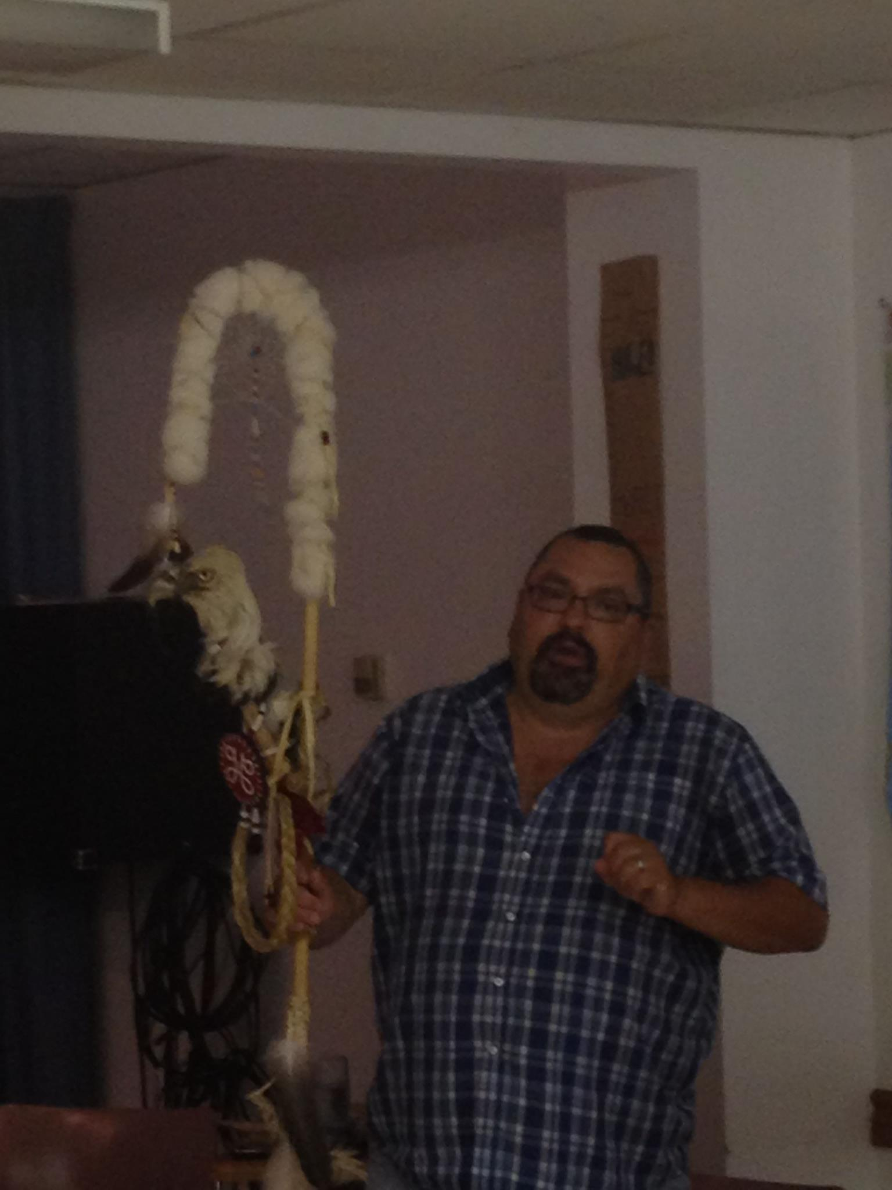
July 25
timeOUT: Healing in Our Communities
Presenter: Gabe Saulnier

Slide 8
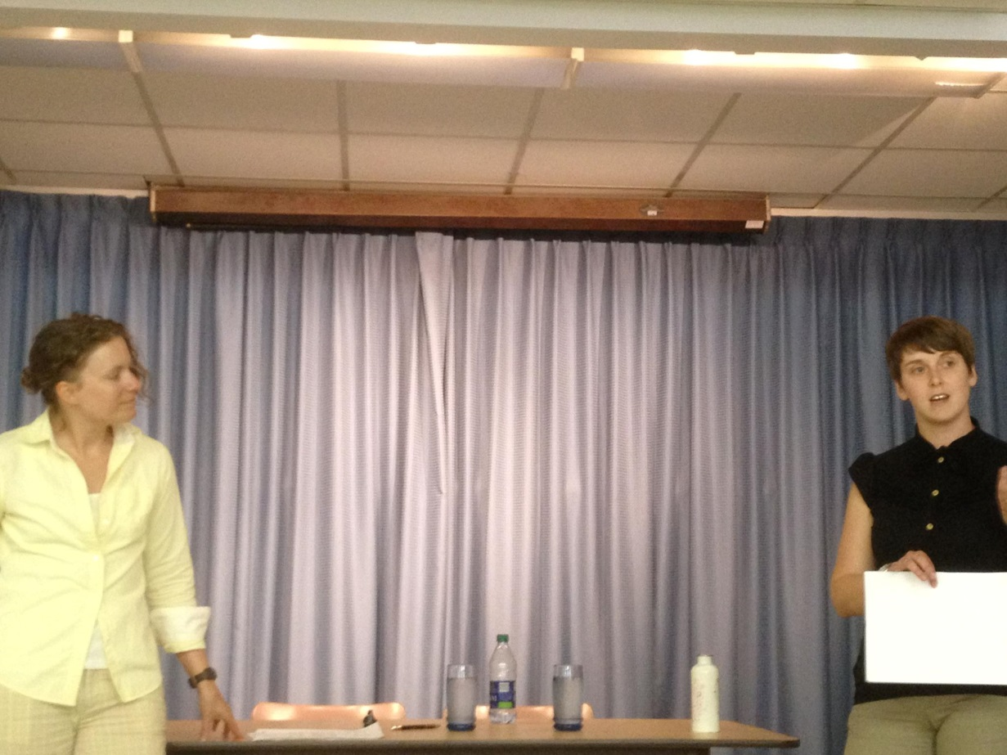
July 26
timeOUT: “Can I talk about this here?” – LGBTQ health care
Presenters: Erin Fredericks and Amy Warren

Slide 9
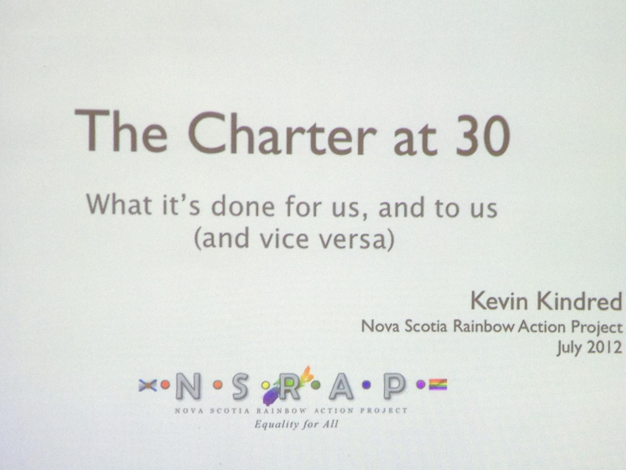
July 27
timeOUT: The Charter at 30: What it’s done for us, and to us, and vice versa
Presenter: Kevin Kindred

Slide 10
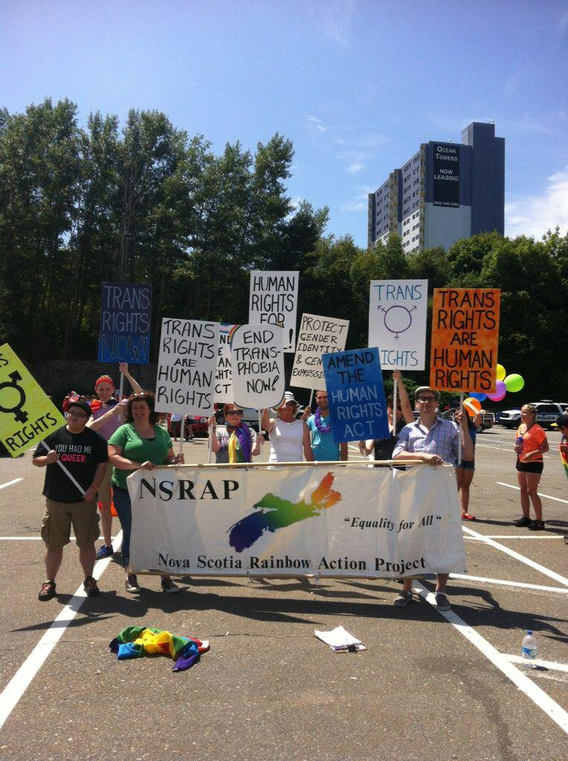
July 28
NSRAP and Trans Family Nova Scotia in the Halifax Pride Parade.

Slide 11
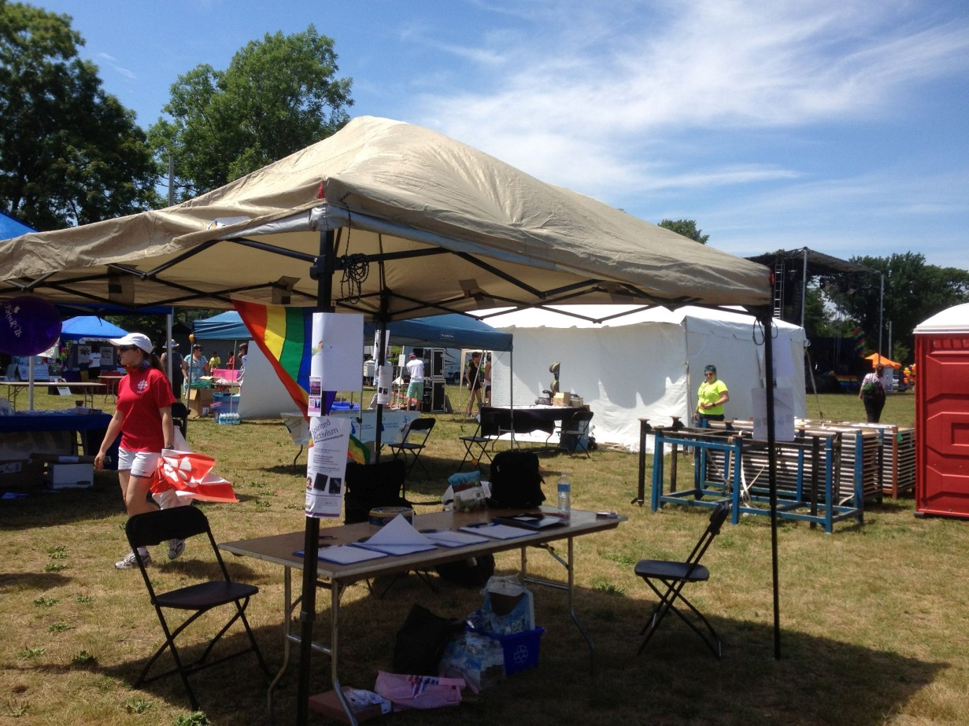
July 28
NSRAP collected signatures for our human rights petition at the Halifax Pride community fair.
(…and our booth eventually got much better-looking)

Slide 12
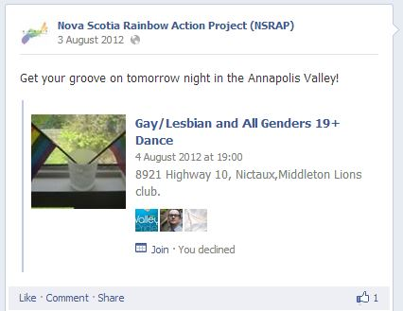
August 4
Annapolis Valley Pride Dance – we collected more signatures for our human rights petition.

Slide 13

August 11
Director Rebecca Rose and volunteers representing NSRAP in the Pride Cape Breton Parade.

Slide 14
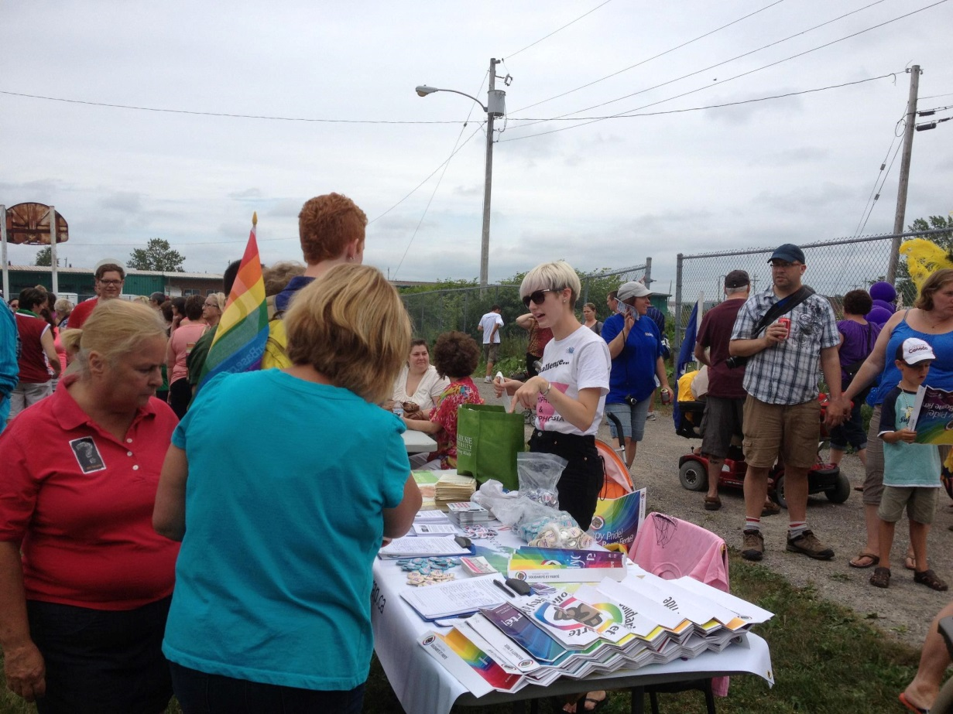
August 11
Pride Cape Breton Community Fair – NSRAP partnered with Canadian Federation of Students for a table at the community fair where we collected signatures for our human rights petition.

Slide 15
August 21
Rev. Darlene Young Community Hero Award: Karen Finnigan
Raymond Taavel Media Award: Jesiah MacDonald
Corporate Stewardship Award: prideHealth
Announcement of our 2012 Awards recipients:

Slide 16
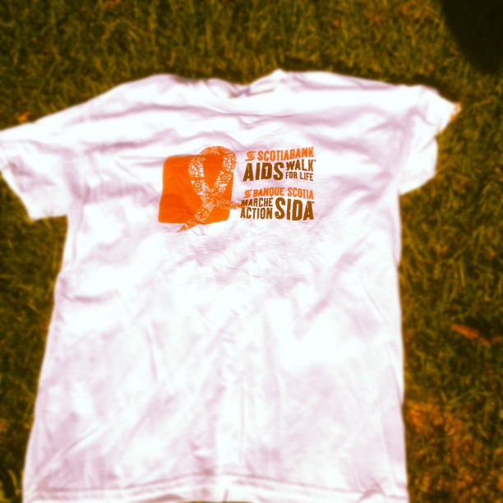
September 23
NSRAP had a team in the Halifax ScotiaBank AIDS Walk for Life.

Slide 17
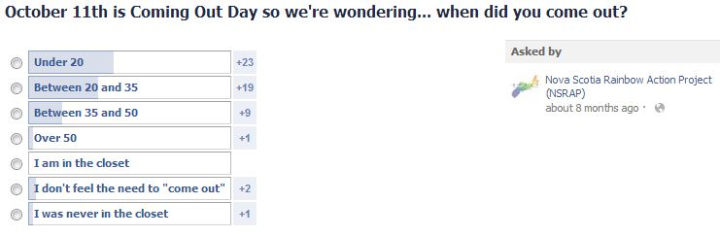
October 11
Raised awareness of Coming Out Day through an informal poll on the age at which people came out.

Slide 18

October 20
Third annual Spirit Day – participants are encouraged to wear purple to recognize and challenge bullying of LGBTQ youth.

Slide 19

October 20
NSRAP Gala: Spirited Activism
Keynote speaker: The Honourable Darrell Dexter
MC: Candy Palmater
Musical performance: Stewart Legere

Slide 20

October 20
Gala - NSRAP Board members: Lucas Thorne-Humphrey, Rosie Porter, Alana Murray, Brenda Merritt, Nathaniel Lewis, Kate Keough, Kevin Kindred and Kate Shewan at the Spirited Activism gala.
Photo by Timothy Richard.

Slide 21

October 26
Intersex Awareness Day – educational information was shared via social media.

Slide 22

November 1
NSRAP was honoured again as the Silver Winner for Best Activist Organization in The Coast, Halifax's Weekly "Best of Halifax 2012."

Slide 23
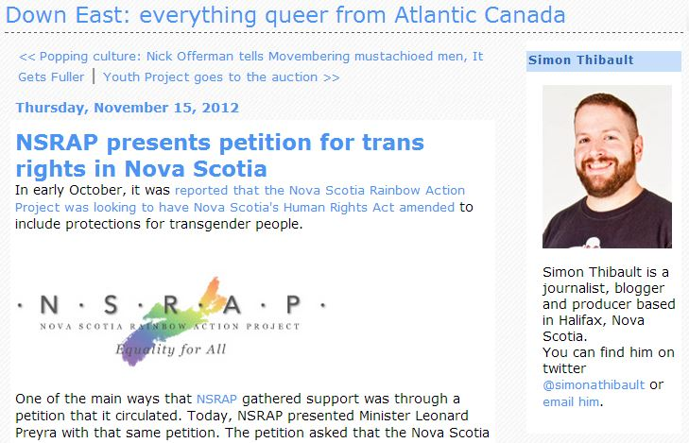
November 15
The formal submission to the Honourable Leonard Preyra of our petition with more than 1,700 signatures.

Slide 24
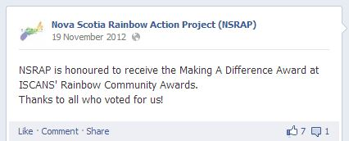
November 17
The Imperial Sovereign Court Of Atlantic Nova Society Inc. (ISCANS) presented NSRAP with the “Making A Difference Award” at their annual Rainbow Community Awards.

Slide 25
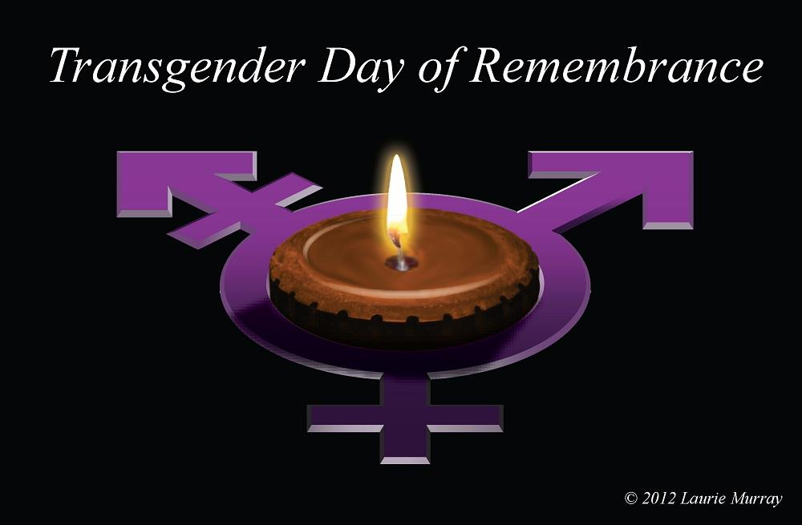
November 20
Transgender Day of Remembrance (TDOR) – remembering those members of the trans community who were killed due to transphobic violence.

Slide 26
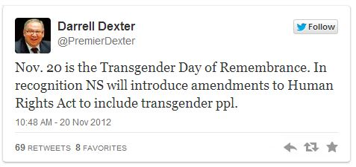
November 20
On the Transgender Day of Remembrance, the provincial government introduced Bill 140 to add gender identity and gender expression to the Nova Scotia Human Rights Act.

Slide 27
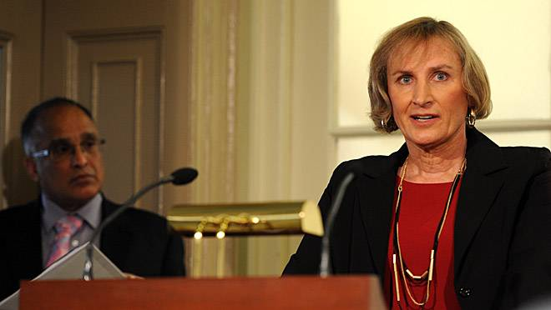
November 20
NSRAP Board member Kate Shewan speaks at the province’s announcement of their move to

Slide 28
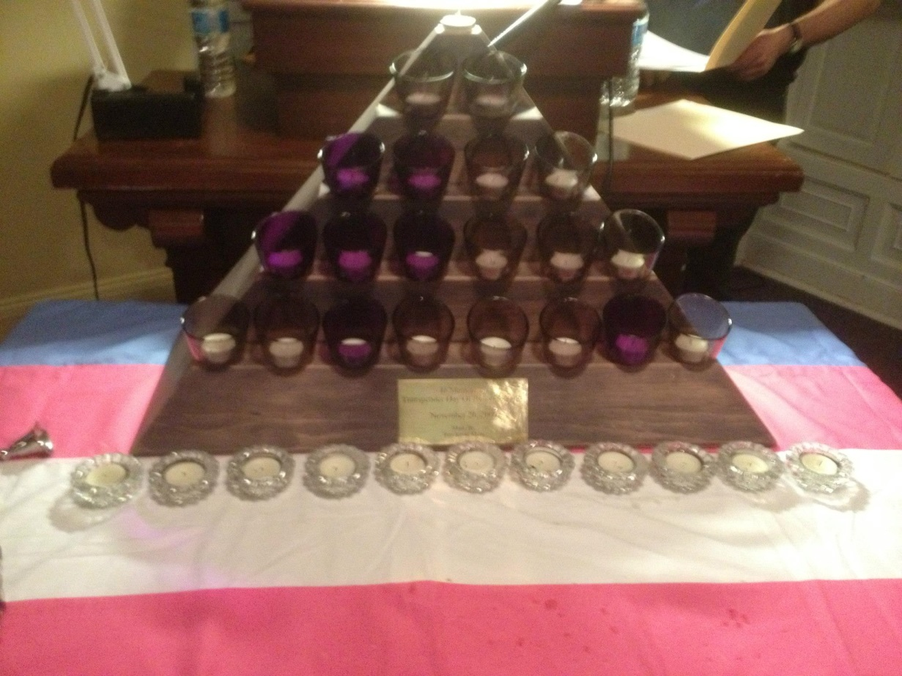
November 23
TDOR service in Halifax, held at the Universalist Unitarian Church.
November 23rd also marked the second reading of Bill 140 in the legislature.

Slide 29
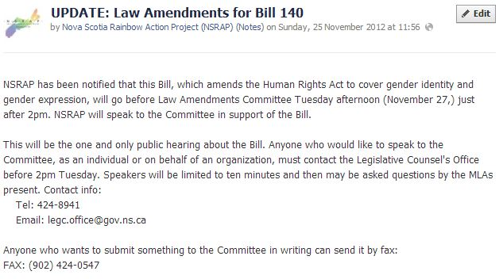
November 27
NSRAP presented to the Law Amendments Committee in favour of Bill 140.

Slide 30
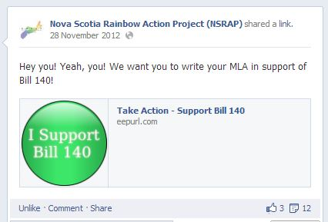
November 28
As Bill 140 went in for its third (and final) reading, NSRAP encouraged our membership and allies to write to their MLA in support of the Human Rights act amendment.

Slide 31

November 29
“Is HIV stigma fueling new HIV infections among gay/bi men?” panel discussion as part of AIDS Awareness Week.

Slide 32
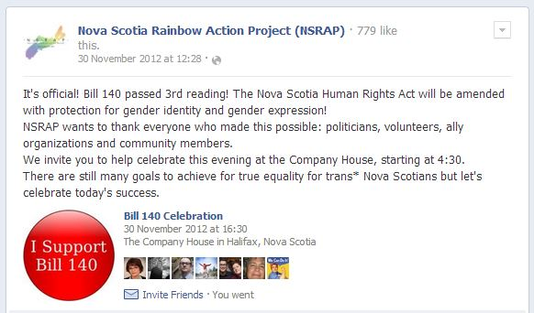
November 30
Bill 140 passes its third reading – the Nova Scotia Human Rights Act would be amended to include gender identity and gender expression.
NSRAP convened a celebration at the Company House!

Slide 33
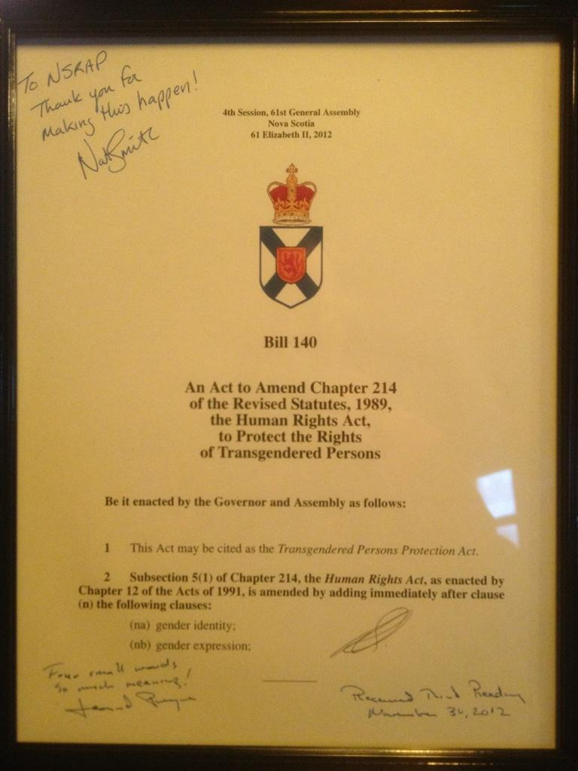
November 30
The Honourable Leonard Preyra presented NSRAP with a signed copy of Bill 140.

Slide 34

December 1
Kevin Kindred and Kirk Furlotte presented at the Youth Project’s 2012 GSA conference.

Slide 35

February 12
NSRAP hosted a talk on the origin of Pink Triangle Day and its future by Robin Metcalfe.

Slide 36

February 15
A guided talk about the Hfx.Pride88 History Exhibit, that was displayed at the Spring Garden Road Memorial Public Library, originally commissioned by Halifax Pride.

Slide 37

April 17
An Act of Remembrance for Raymond Taavel – display your pride to remember a powerful activist.

Slide 38
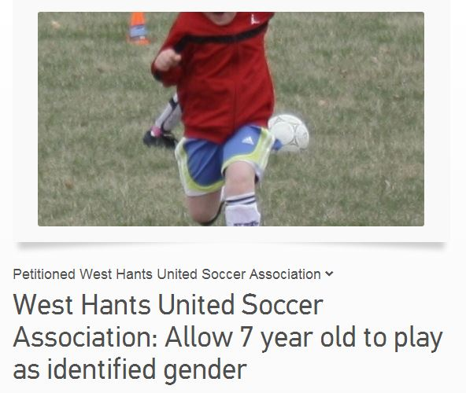
April 30
Chair Kevin Kindred spoke on behalf of a family whose child identified as a boy but was not permitted to play on an all-boys soccer team. The soccer association announced on May 1 that it had reversed its decision.

Slide 39
May
NSRAP has been working on a committee formed through the Department of Education and Early Childhood Development to develop guidelines for supporting transgender and gender non-conforming students and staff in Nova Scotia schools.
We will soon be launching a survey to gain input from trans Nova Scotians into these guidelines. We are working with the Youth Project to host focus groups with trans youth and to build a resource to support the guidelines that will be accessible to school staff. Our involvement will continue throughout the launch of the guidelines in September 2013 and the rollout, including the professional development for school staff that will follow.

Slide 40

May 16
NSRAP lead a committee of community groups and activists in organizing the 2013 Rally for the International Day Against Homophobia & Transphobia.

Slide 41
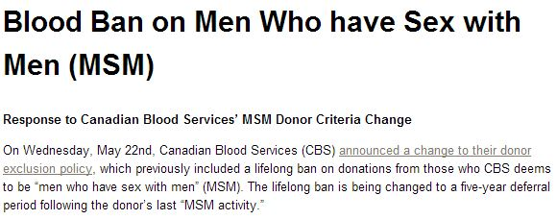
May 22
Canadian Blood Services announced that it would seek to change its policy preventing men who have had sex with men (MSM) from a lifetime deferral for blood donation to a five-year deferral based on last sexual encounter. While not a major victory, NSRAP (through Health Committee chair Lucas Thorne-Humphrey) had been one of CBS’ advisors and recognized this as an important first step towards a behavior-based screening tool.

Slide 42
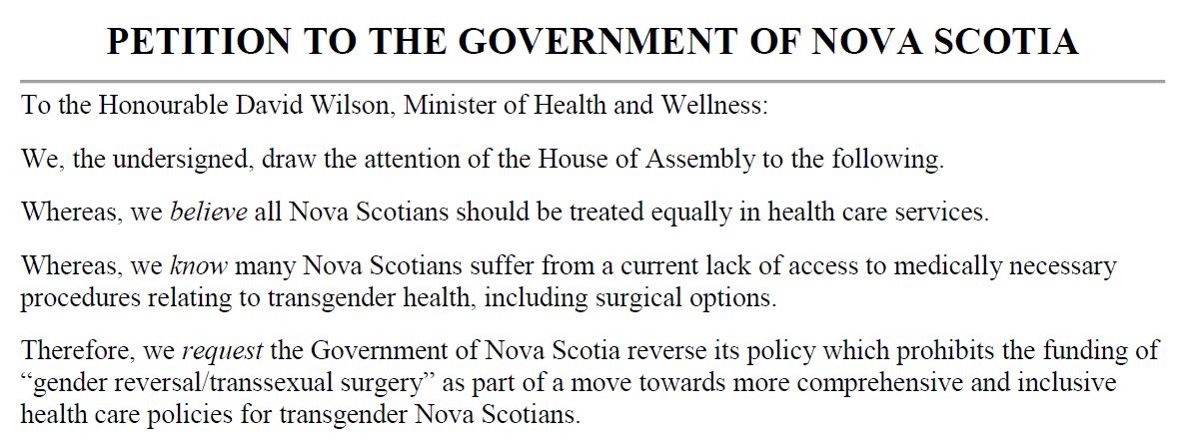
May
NSRAP soft launches its schedule for the summer: a petition and letter-writing campaign to amend the Physician’s Manual which prevents doctors from billing for “gender reversal/transsexual surgery.”

Slide 43

May 22
Board member Kirk Furlotte participated in the Youth Project’s GSA Roadshow in New Glasgow.
GSA students had the chance to be some of the first to sign our 2013 petition.

Slide 44
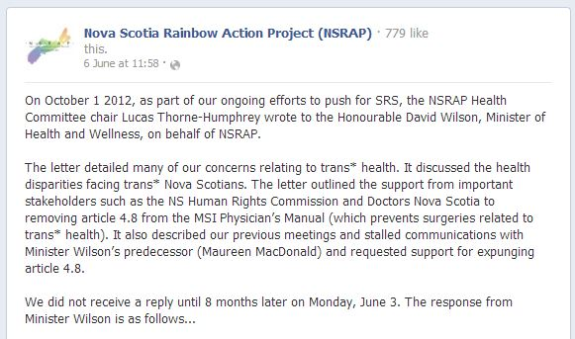
June 6
NSRAP shares a letter received from the Minister of Health and Wellness that outlined the government’s decision not to fund sex reassignment surgeries (SRS) in Nova Scotia.
This Facebook post ignited the passion of the community – over 30 shares, lead to over 4,200 people seeing this one post.

Slide 45

June 6
NSRAP’s campaign consisted of:
A form letter on our Web site to contact the Minister of Health and Wellness, along with the two health critics.
A plan to circulate the petition at events throughout the summer.
A downloadable version of the petition so community members could gather their own signatures.
Questions and answers on SRS so community members could become better educated.
A push to write to your MLA.
Encouragement to share the campaign with others.

Slide 46
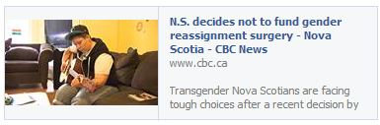
June 11
CBC interviews trans youth Parker Jackson and Kevin Kindred on the impact of the announcement that SRS would not be covered.
On the morning of the 12th, Kevin Kindred and Kate Shewan both did radio interviews talking about the toll this places on the trans community.

Slide 47
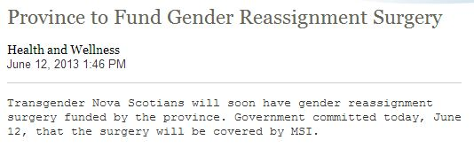
June 12
NSRAP Board members Kevin Kindred, Lucas Thorne-Humphrey and Lisa Buchanan met with the Honourable David Wilson, Minister of Health and Wellness in the morning. We got a firm commitment from the government that they will work to eliminate the barriers and ensure that SRS is funded in Nova Scotia.
Later that day, a news release said that section 4.8 of the Physician’s Manual would be removed immediately.

Slide 48
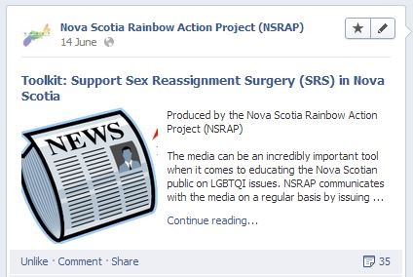
June 14
In response to negative comments and feedback to news coverage of the June 12th decision, NSRAP created a toolkit to help people fight for positive coverage in the media.

Slide 49

June 23
Following NSRAP AGM…
NSRAP, TRANSform Health Care, South House, NSPIRG, the Youth Project, Trans Family, members of the trans community and allies celebrate the recent announcement by the provincial government that SRS will be covered in Nova Scotia.

